Slide 1
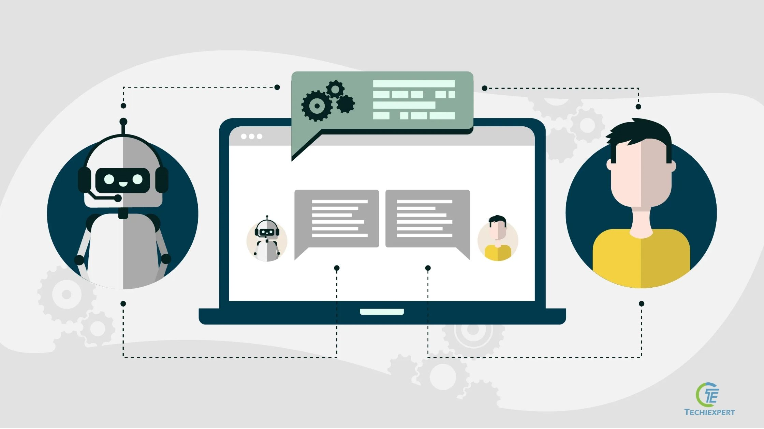
TITLE Health Care Chatbot using Deep Learning and NLP

Slide 2

Group Number : 18
Group Members :
Karan. J. Jaiswar (25)
Pritam. P. Tawade (52)
Sanket. S. Wankhade (58)

Slide 3
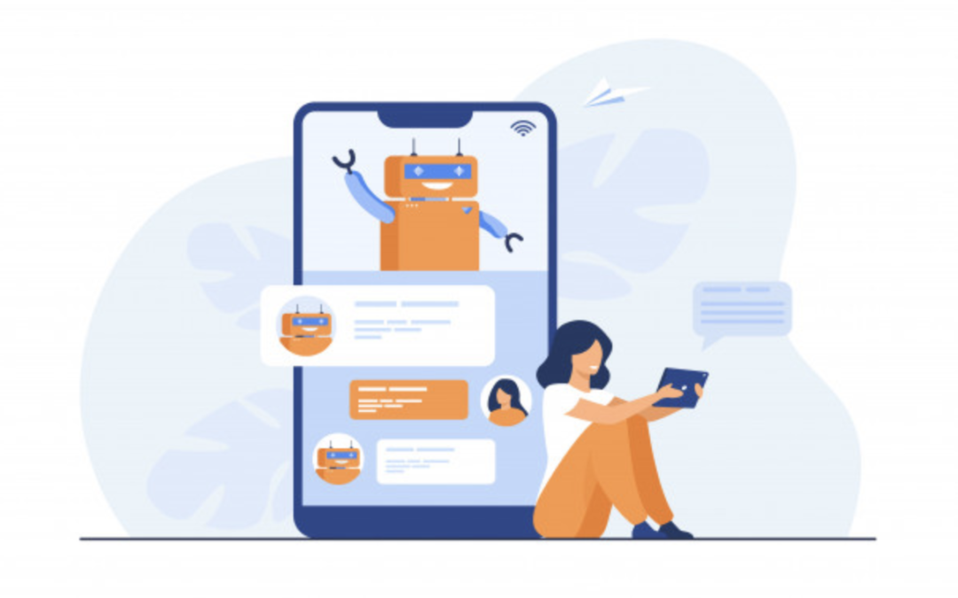
What are chatbots ?
A chatbot is a computer program that takes the place of a natural human conversation online.
A chatbot is an artificial intelligence (AI) program that can simulate a conversation (or a chat) with a user in natural language through messaging applications, websites, mobile applications or by phone.

Slide 4

Need For Chatbot??
Save Human Resources for Qualitative Tasks
Automated Customer Support For Similar Queries
Accelerate Operations
Chatbot- Easy-to-use
Cost-effective and Time-efficient
Improves Work With Minimum Effort

Slide 5
Types of Chatbot? And which one is our??
Rule-Based Chatbots – They follow a set of pre-defined rules or flows to respond to queries of a user. Most simple applications contain rule-based chatbots, which respond to questions based on the preset rules.
AI Chatbots – AI chatbots are more advanced and based on machine learning. AI chatbot uses natural language processing services to understand the meaning behind the questions posed.
AND WE HAVE CREATED AN “AI CHAT BOT”

Slide 6

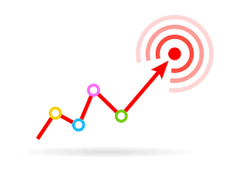
Objective :
Chat bots are mainly used to provide customer support.
Can Schedule meetings, Broadcast newsletters, auto-sequences
Chat bots are very intelligent. You train them once and they will communicate with your target audience in their language.

Slide 7
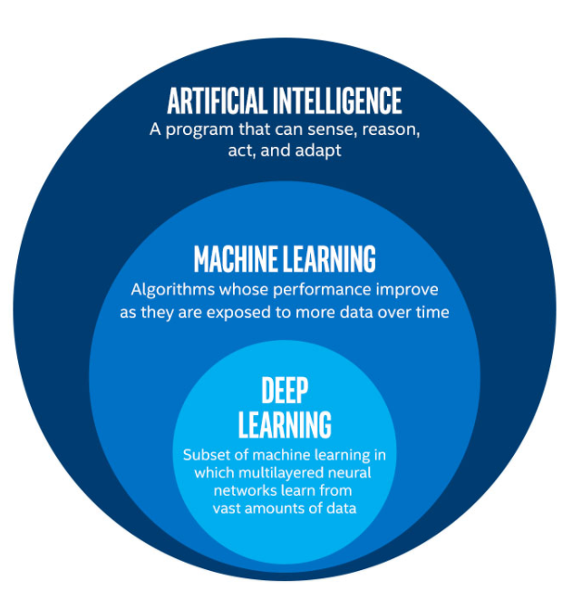
What is AI,ML and Deep Learning??
Fig.1

Slide 8

What is Deep Learning ?
Deep learning is a technique that teaches computers to do what comes naturally to humans: learn by example. Deep learning is a key technology behind driverless cars, enabling them to recognize a stop sign. It is the key to voice control in consumer devices like phones, tablets, TVs, and hands-free speakers.
Deep learning is getting lots of attention lately and for good reason. It’s achieving results that were not possible before.
Deep learning is basically a computer model which learn to perform task.
Deep learning is basically an upgraded version of Machine learning and has some advanced features than machine learning.

Slide 9

What is NLP ?
NLP is basically Natural Language Processing.
The field of study that focuses on the interactions between human language and computers is called Natural Language Processing
NLP is used to analyze text, allowing machines to understand what human’s had text.
NLP are based on Machine Learning and especially statistical learning which uses a general learning algorithm.
So using Deep learning we are going to solve basic NLP tasks.
The basics concepts of NLP we will use are Stemming, tokenization, Training Data.

Slide 10
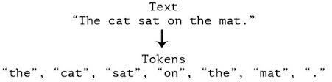
Tokenization :

Slide 11
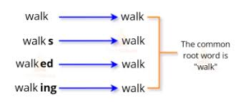
Stemming :

Slide 12
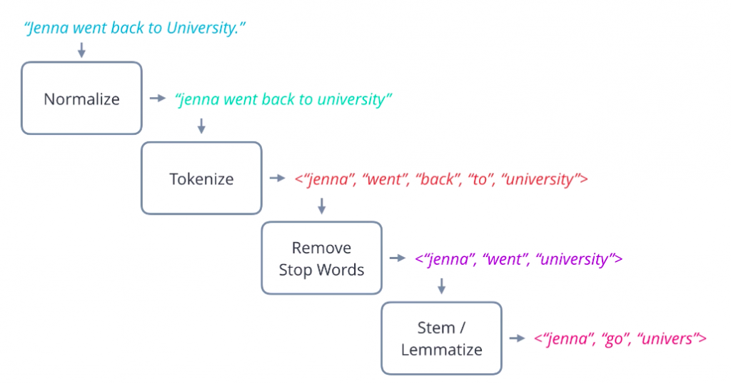
Example:-

Slide 13
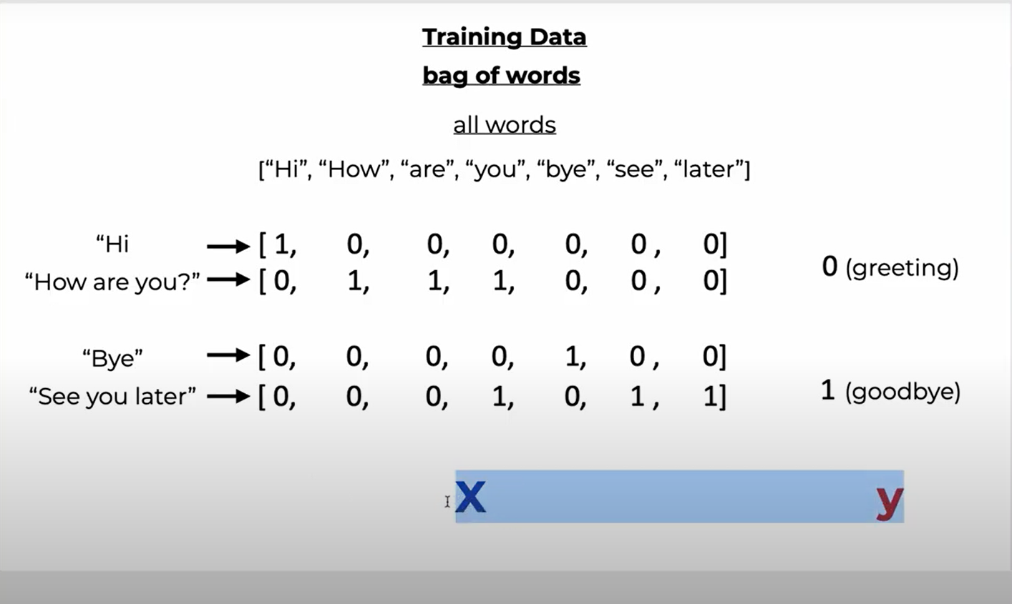
Bag of Words :-

Slide 14
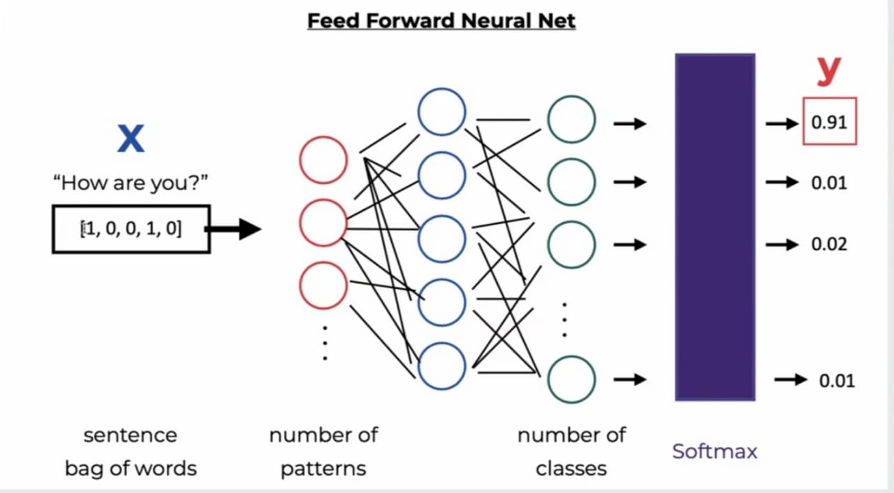
Training of Model:-
Neural Net:-
Fig.7

Slide 15
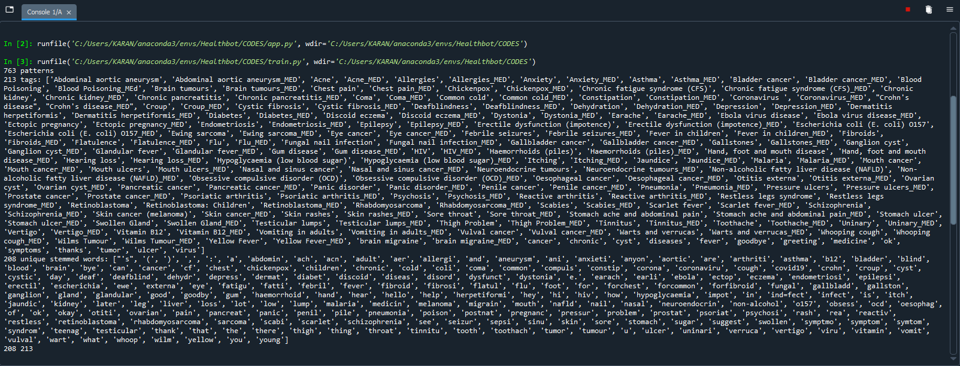
Training of data :-

Slide 16
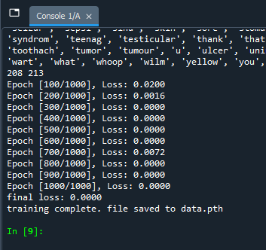
Training of data:-

Slide 17
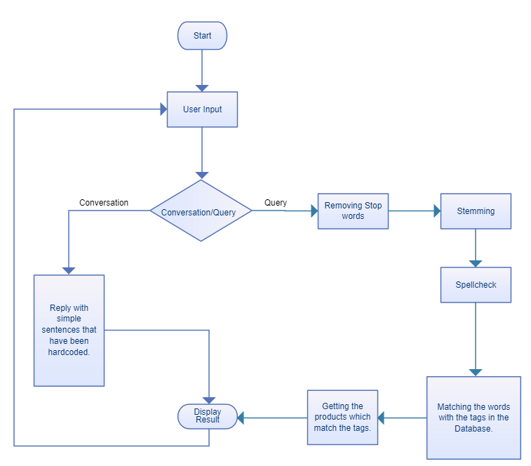
How Chatbot Works….

Slide 18
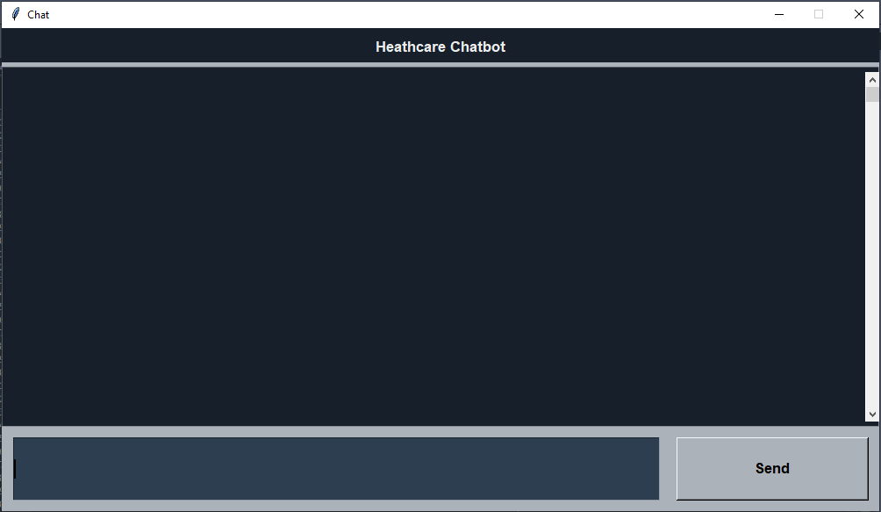
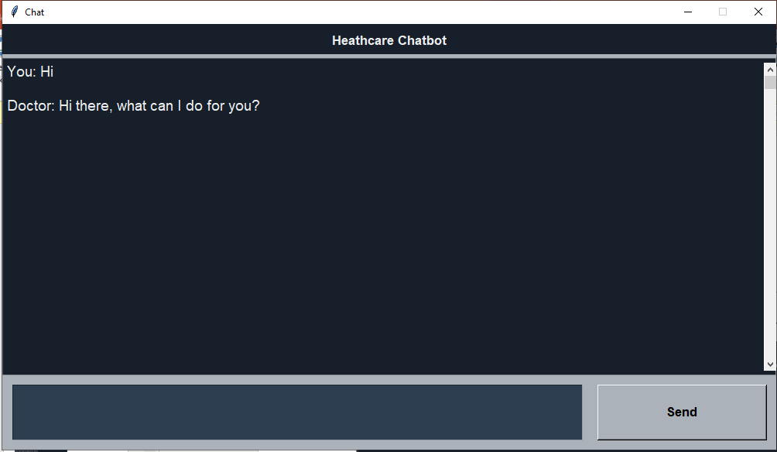
How our chatbot works….

Slide 19
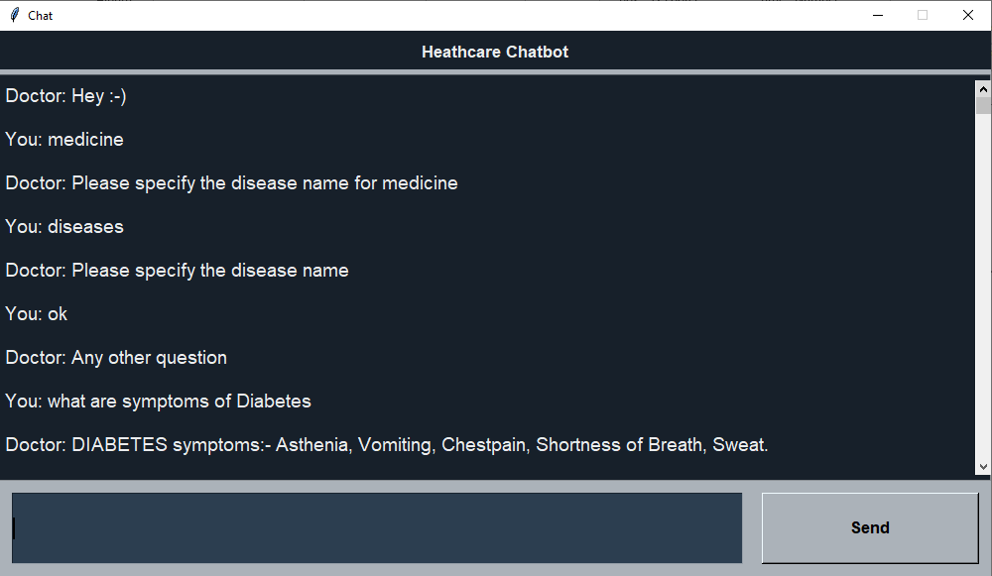
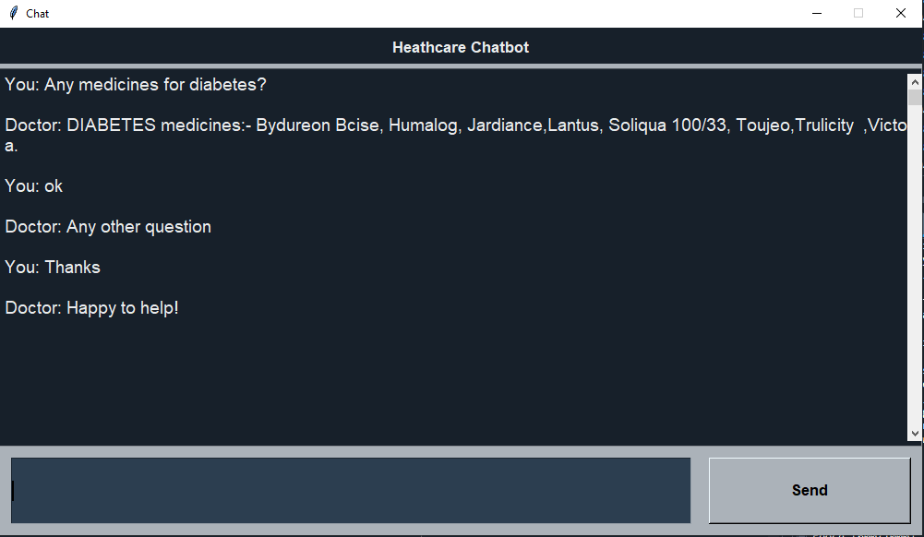

Slide 20
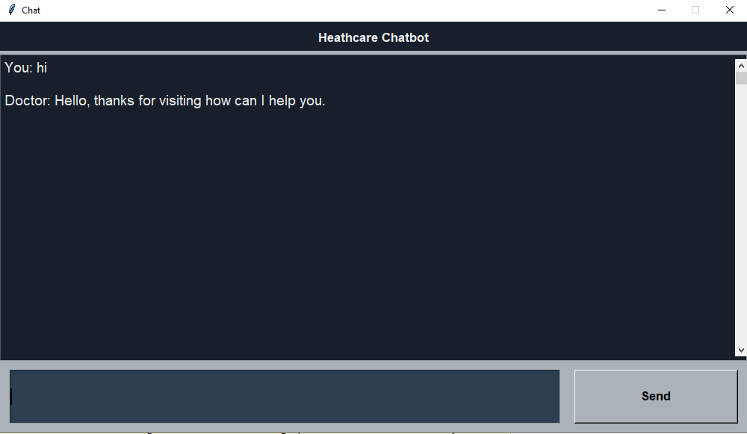
Creating of GUI

Slide 21
Tkinter is the standard GUI library for Python. Python when combined with Tkinter provides a fast and easy way to create GUI applications. Tkinter provides a powerful object-oriented interface to the Tk GUI toolkit. Tkinter provides various controls, such as buttons, labels and text boxes used in a GUI application. These controls are commonly called widgets.

Slide 22
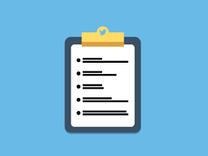

Scope
“Creating chatbot using deep learning and nlp have great scope in future because both of them are well known technology in the AI world and using them we can improve the link between computers and human much better.”

Slide 23
LITERATURE SURVEY AND PAPER REVIEW
No. | Paper Title | Authors | Descriptions
1 | A Smart Chatbot Architecture based NLP and Machine learning for health care assistance. | Soufyane Ayanouz,Mohammed Benhmed, Boudhir Anouar Abdelhakim | Explain importance of chatbot and how we improve it using NLP and ML according to the scientific community, chatbots are user-friendly and any person who has an awareness of typing in their language on the desktop version and in the mobile application can use these chatbots very easily
2 | An Intelligent Chat-bot using Natural Language Processing | Rishabh Shah, Siddhant Lahoti, Prof. Lavanya. K | Experiment with small dataset with some dynamic variables and different algorithm, Different algorithms have been used and with technology evolving the retrieval process including the triggering part is getting faster.
3 | BANK CHAT BOT – An Intelligent Assistant System Using NLP and Machine Learning | Chaitrali S. Kulkarni,Amruta U. Bhavsar, Savita R. Pingale, Prof.Satish S.Kumbhar | They have entered queries which are similar to the questions asked while creating bank accounts. The analysis of the result is as 87% correct answer and 13% incorrect answer

Slide 24
No. | Papers | Authors | Description
4 | Chatbot using NLP and Deep Learning | Ravi Khevaria | Training the dataset now the chatbot is tested by running various commands in the terminal. After training the model now the chatbot is ready to be tested. The output generated by the chatbot has moderate relevancy
5 | Implementation of a Chatbot System using AI and NLP | Tarun Lalwani,Shashank Bhalotia, Ashish Pal,Shreya Bisen, Vasundhara Rathod | The purpose of a chatbot system is to simulate a human conversation. Its architecture integrates a language model and computational algorithm to emulate information online communication between a human and a computer using natural language

Slide 25
Conclusion:-
The main objectives of the project is to develop an chatbot using DL and NLP that will answer to user about diseases , symptoms and medicine. Basically in this we have used basic concept's of both NLP(Natural Language Processing) and DL(Deep Learning). First we used an raw data, basically a group of sentences and after cleaning the data we apply our DL models (Feed Forward Neural Net) which will provides the expected results, and using the GUI we will interact with the Chatbot . So in this way we are going to accomplished the chatbot which uses deep learning and NPL.

Slide 26
Reference :
https://chatbotsmagazine.com/contextual-chat-bots-with-tensorflow-4391749d0077
https://sloboda-studio.com/blog/how-to-use-nlp-for-building-a-chatbot/
https://www.google.com/
https://www.nhsinform.scot/illnesses-and-conditions/a-to-z
https://www.nltk.org/
https://towardsdatascience.com/top-deep-learning-articles-of-2020-2b9a8c869875

